Slide 1
Logistic regression using DEEP Neural networks – Part 1
Topics:
Logistic regression
Neuron with complex activation functions
Delta learning rule or Adaline network
Iris Classification

Slide 2
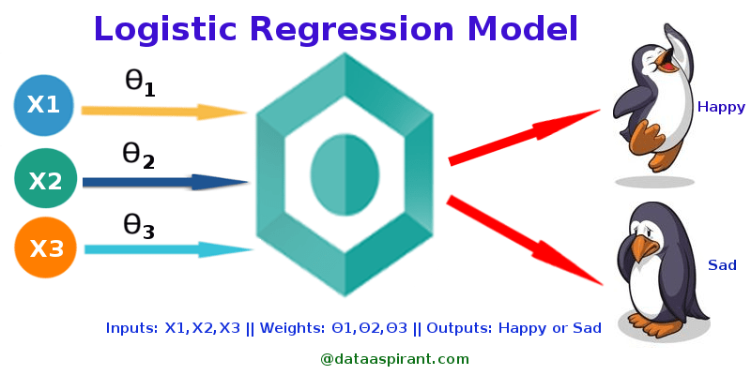
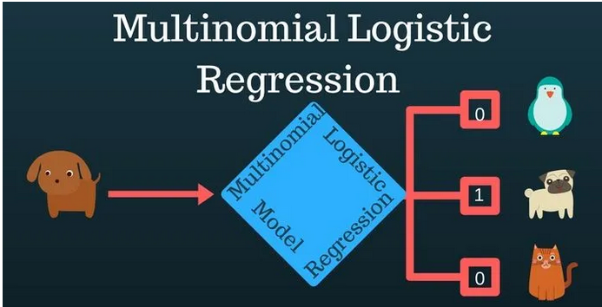
Logistic regression
Logistic Regression is a method to model the probability of a particular class or event to exist.
Logistic Regression is used for classification.
Logistic Regression can be used as binomial or binary logistic regression, where there are only two possible outcomes. Example: Spam or not Spam
Logistic Regression can also be used as multinomial logistic regression, where there are three or more possible outcomes.
The output of Logistic Regression threshold the output to either of the two possible binary outcomes in the case of binary logistic regression or a predetermined number of categories in the case of multinomial logistic regression

Slide 3
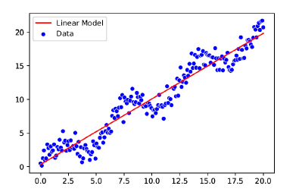
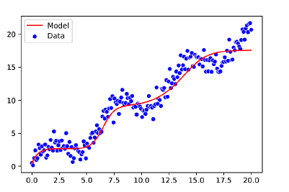
Linear regression
Linear Regression is a linear approach to model the relationship between a numerical response variable $Y$ and one or more explanatory variables $Xs$
Using neurons with complex activation functions, a regression network can be made to learn a non-linear function.
Ref: Inside Deep Learning Math, Algorithms, Models, Edward Raff

Slide 4
complex Activation Functions

Slide 5
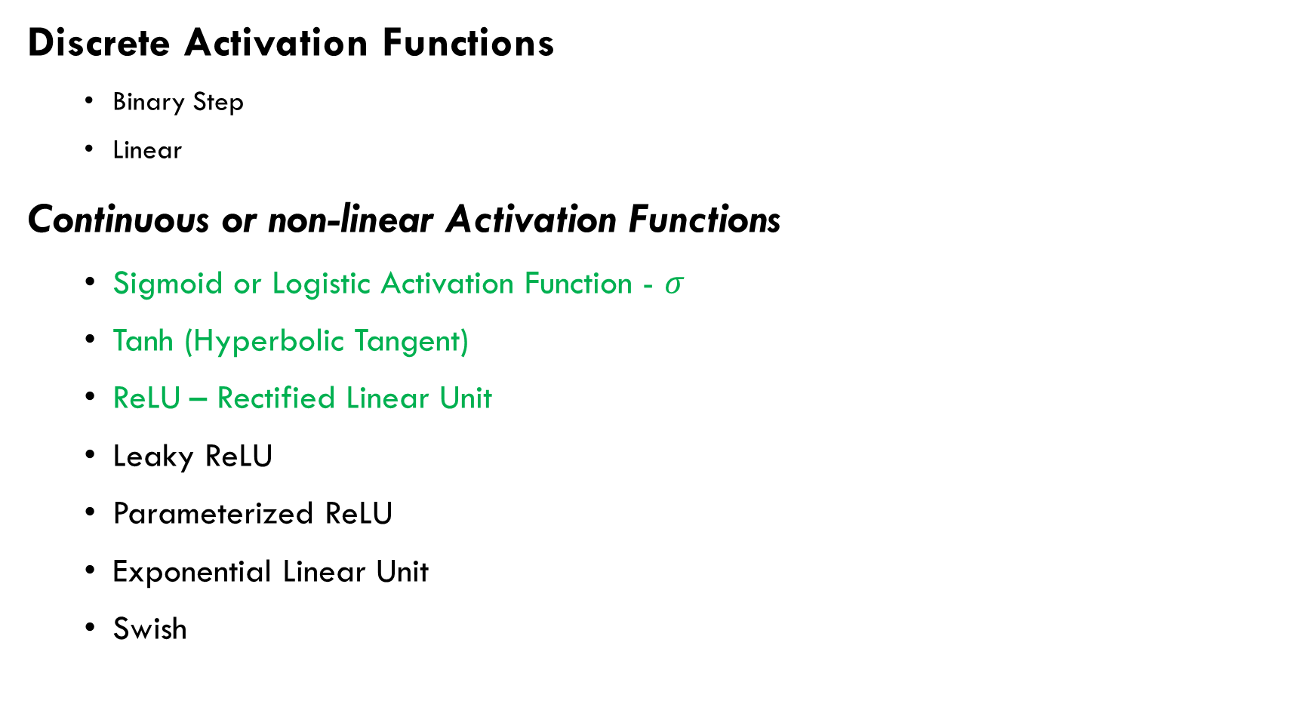
Non Exhaustive list of activation functions
Discrete Activation Functions
Binary Step
Linear
Continuous or non-linear Activation Functions
Sigmoid or Logistic Activation Function - $σ$
Tanh (Hyperbolic Tangent)
ReLU – Rectified Linear Unit
Leaky ReLU
Parameterized ReLU
Exponential Linear Unit
Swish

Slide 6
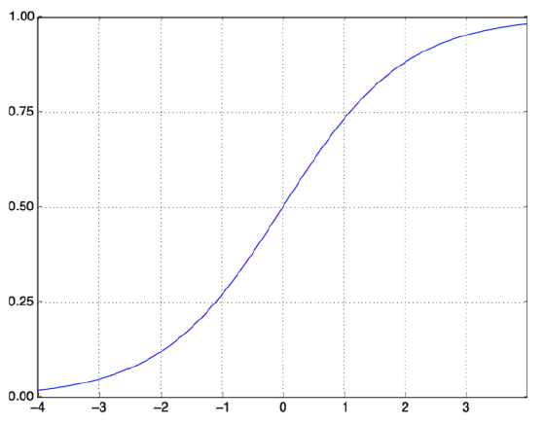
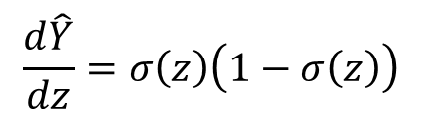

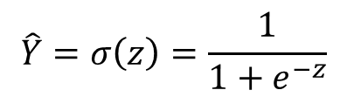
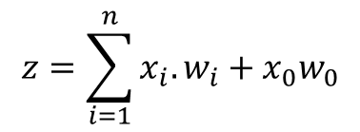

Non-linear activation functions
Sigmoid or Logistic Activation Function - $σ$
x₀ = 1
w₀
x₁
w₁
z
∑
$$σ$$
Output $\hat{Y}$
w₂
x₂
w_{n}
x_{n}
$$z=\sum_{i=1}^{n}{x_{i}.w_{i}}+x_{0}w_{0}$$
$$\hat{Y}=σ\left(z\right)=\frac{1}{1+e^{−z}}$$
$$\frac{d\hat{Y}}{dz}=σ\left(z\right)\left(1−σ\left(z\right)\right)$$
Ref: Deep Learning with Python, 2nd Edition, Francois Chollet

Slide 7
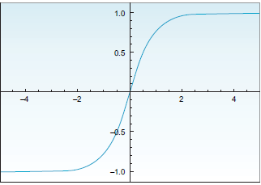

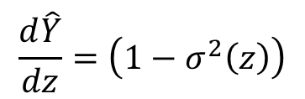

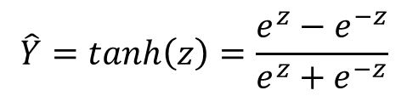
Non-linear activation functions
Tanh Activation Function
x₀ = 1
w₀
x₁
w₁
z
∑
$$tanh$$
Output $\hat{Y}$
w₂
x₂
w_{n}
x_{n}
$$z=\sum_{i=1}^{n}{x_{i}.w_{i}}+x_{0}w_{0}$$
$$\hat{Y}=tanh\left(z\right)=\frac{e^{z}−e^{−z}}{e^{z}+e^{−z}}$$
Ref: Deep Learning for Vision Systems, Mohamed Elgendy
$$\frac{d\hat{Y}}{dz}=\left(1−σ^{2}\left(z\right)\right)$$

Slide 8
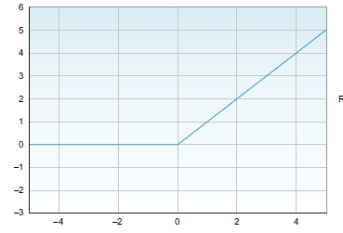
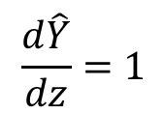

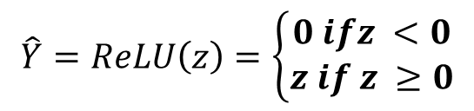


Non-linear activation functions
Rectified Linear Unit Activation Function - ReLU
x₀ = 1
w₀
x₁
w₁
z
Output $\hat{Y}$
∑
$$ReLU$$
w₂
x₂
w_{n}
x_{n}
Ref: Deep Learning for Vision Systems, Mohamed Elgendy
$$z=\sum_{i=1}^{n}{x_{i}.w_{i}}+x_{0}w_{0}$$
$$\hat{Y}=ReLU\left(z\right)=max⁡(0,z)$$
$$\hat{Y}=ReLU\left(z\right)=\left\{\begin{matrix}0 ifz <0 \\ z if z ≥0\end{matrix}\right.$$
$$\frac{d\hat{Y}}{dz}=1$$

Slide 9
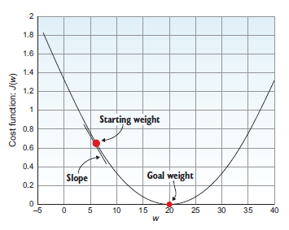
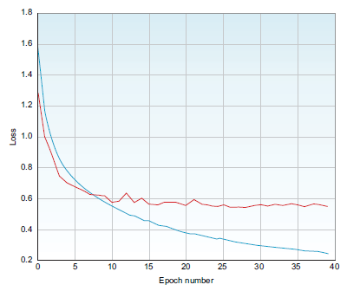
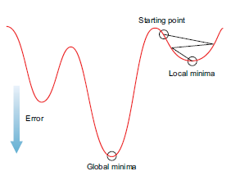
Neurons with Non-linear activation functions activation function or Adaline network
Training a Neuron with Continuous Activation Function or Adaline network involves minimizing the Error or Loss or Cost function.
Training involves minimizing the error with respect to the weights of the neuron.
The goal is to reach the minimum error which may or may not be the global minimum by updating the weights of the network appropriately.
Depending on the type of task (regression or classification), an appropriate Error or Loss or Cost function is selected
Gradient Optimization Algorithms are used to update the weights of the network to reach the local or global minima

Slide 10
Network Training

Slide 11
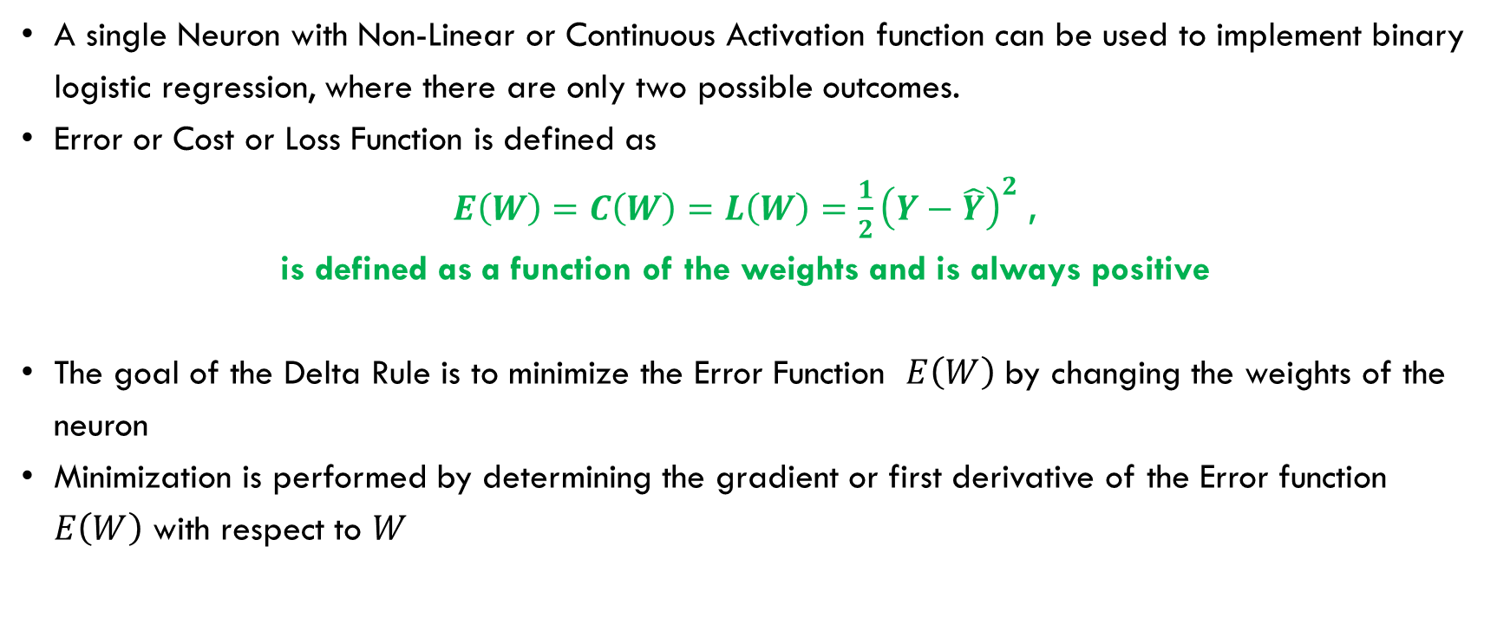
Logistic regression - training with delta rule
A single Neuron with Non-Linear or Continuous Activation function can be used to implement binary logistic regression, where there are only two possible outcomes.
Error or Cost or Loss Function is defined as
$E\left(W\right)=C\left(W\right)=L\left(W\right)=\frac{1}{2}{\left(Y−\hat{Y}\right)}^{2}$ ,
is defined as a function of the weights and is always positive
The goal of the Delta Rule is to minimize the Error Function $E\left(W\right)$ by changing the weights of the neuron
Minimization is performed by determining the gradient or first derivative of the Error function $E\left(W\right)$ with respect to $W$

Slide 12



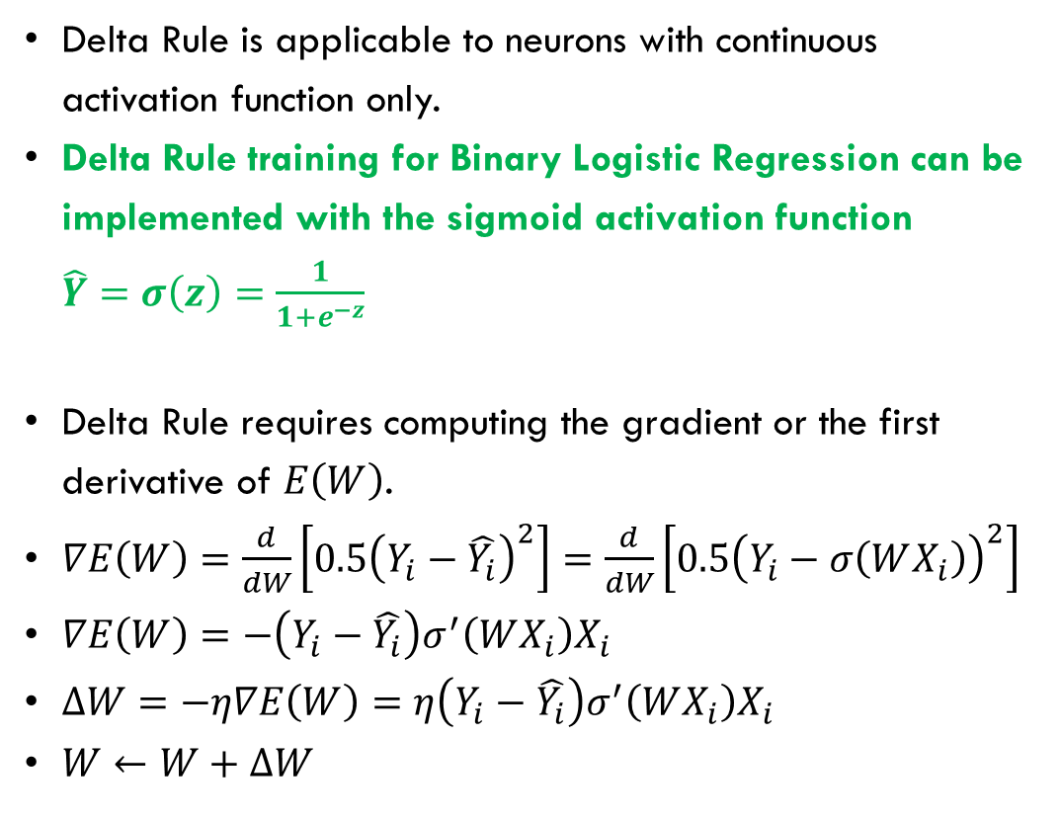

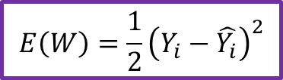

Logistic regression - training with delta rule
Delta Rule is applicable to neurons with continuous activation function only.
Delta Rule training for Binary Logistic Regression can be implemented with the sigmoid activation function $\hat{Y}=σ\left(z\right)=\frac{1}{1+e^{−z}}$
Delta Rule requires computing the gradient or the first derivative of $E\left(W\right)$.
$∇E\left(W\right)=\frac{d}{dW}\left[0.5{\left(Y_{i}−\hat{Y_{i}}\right)}^{2}\right]=\frac{d}{dW}\left[0.5{\left(Y_{i}−σ\left(WX_{i}\right)\right)}^{2}\right]$
$∇E\left(W\right)=−\left(Y_{i}−\hat{Y_{i}}\right)σ^{′}\left(WX_{i}\right)X_{i}$
$∆W=−η∇E\left(W\right)=η\left(Y_{i}−\hat{Y_{i}}\right)σ^{′}\left(WX_{i}\right)X_{i}$
$W←W+∆W$
X_{i}
W
x₁
x₂
.
.
.
x_{n}
1
w₁
w₂
∑|$σ$
$\hat{Y_{i}}$ (Predicted)
w_{n}
w₀
$Y_{i}$ (Desired)
$$E\left(W\right)=\frac{1}{2}{\left(Y_{i}−\hat{Y_{i}}\right)}^{2}$$
$$W←W+∆W$$
$$∆W=−η∇E\left(W\right)$$

Slide 13
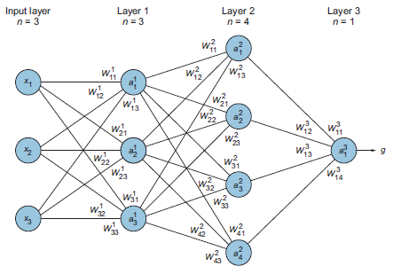
backpropagation
The architecture of a simple three-layer network
The network consists of an input layer with three input features
The network consists of two hidden layers with 3 and 4 neurons
The network consists of an output layer with 1 neuron
The edges between neurons in successive layers are the weights and biases which are to be learned using the training data to predict the output
Ref: Deep Learning for Vision Systems, Mohamed Elgendy

Slide 14
Feedforward process
What is feedforward process?
The term feedforward is used to imply the forward direction in which the information flows from the input layer through the hidden layers all the way to the output layer.
This process happens through the implementation of two consecutive functions: the weighted sum and the activation function.
In short, the forward pass is the calculations through the layers to make a prediction.
Ref: Deep Learning for Vision Systems, Mohamed Elgendy

Slide 15
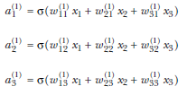

Feedforward process
What is feedforward process mathematically?
In matrix notation,
Ref: Deep Learning for Vision Systems, Mohamed Elgendy

Slide 16
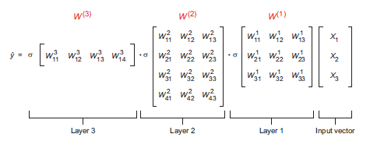
Feedforward process
What is feedforward process mathematically in matrix notation?
Ref: Deep Learning for Vision Systems, Mohamed Elgendy

Slide 17
Backpropagation or backward pass
What is backpropagation?
Backpropagation, or backward pass, means propagating derivatives of the error $\frac{dE}{dW}$ with respect to each specific weight from the output layer back to the input layer to adjust weights.
Propagating weights $\frac{dE}{dw_{i}}$ of a single neuron is simple as shown with Delta Rule
Ref: Deep Learning for Vision Systems, Mohamed Elgendy

Slide 18
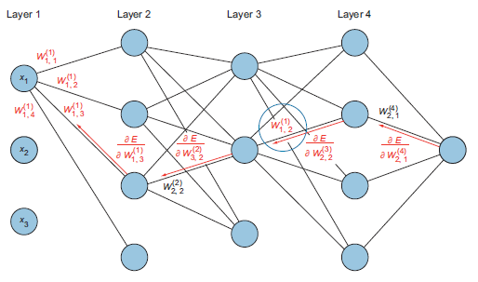
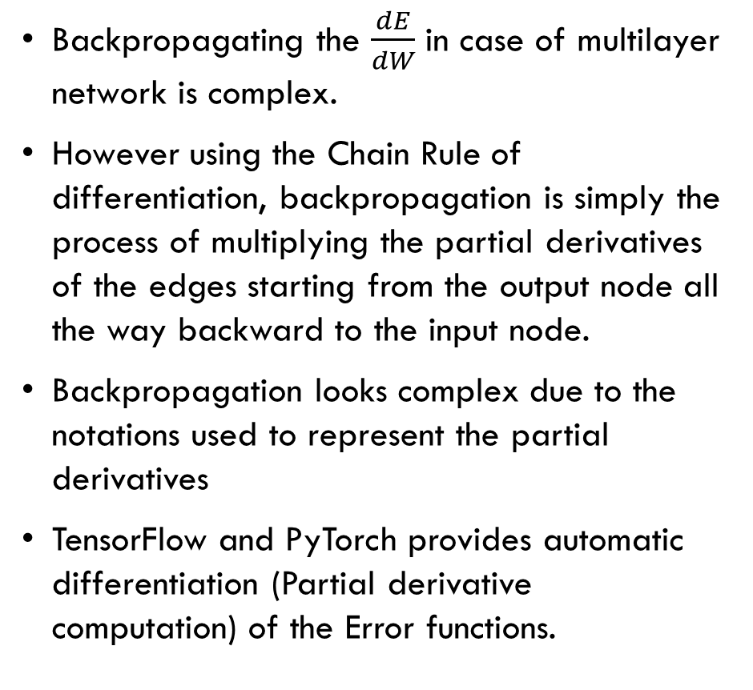
Backpropagation or backward pass
Backpropagating the $\frac{dE}{dW}$ in case of multilayer network is complex.
However using the Chain Rule of differentiation, backpropagation is simply the process of multiplying the partial derivatives of the edges starting from the output node all the way backward to the input node.
Backpropagation looks complex due to the notations used to represent the partial derivatives
TensorFlow and PyTorch provides automatic differentiation (Partial derivative computation) of the Error functions.
Ref: Deep Learning for Vision Systems, Mohamed Elgendy

Slide 19
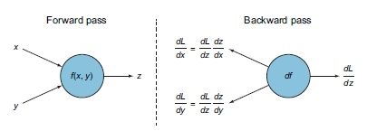
Feedforward and Backpropagation or backward pass
Ref: Deep Learning for Vision Systems, Mohamed Elgendy

Slide 20
Training of a dnn
Present input samples individually to the network and perform feedforward pass to compute the predicted output
Backpropagate the derivatives of the error for each input sample feedforward pass or for all input samples once known as the full batch processing or a subset of input samples known as minibatch processing.
Update the weights from the output nodes to the input nodes.
Repeat the feedforward pass and backpropagation pass until the error is reduced below the desired tolerance.

Slide 21
Programming DNN

Slide 22
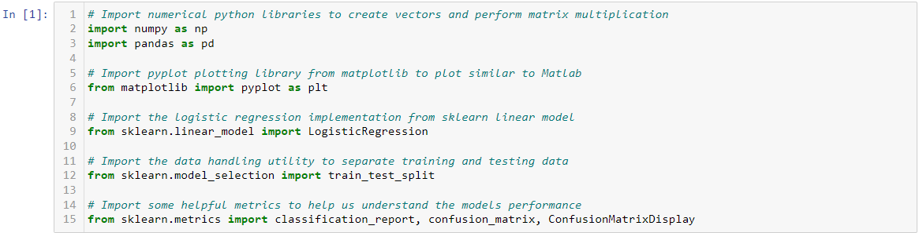
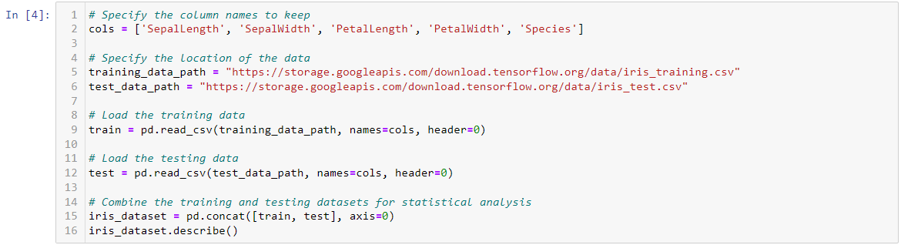
Iris Classification with Regression

Slide 23
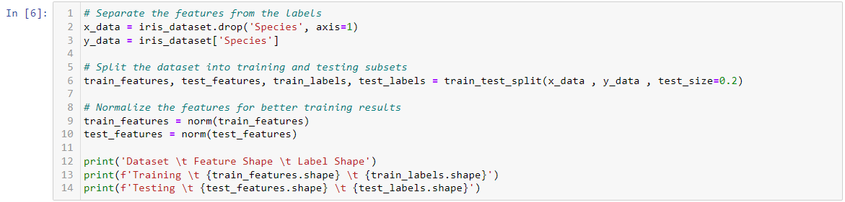
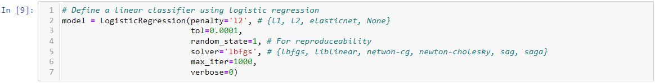
Iris Classification with Regression

Slide 24
Iris Classification with Regression

